Slide 1
Software Engineering
UCT305 CSBS
Introduction to Software Engineering
Software Vs Hardware

Slide 2


What is software?
Computer programs and associated documentation
Software products may be developed for a particular customer or may be developed for a general market
Software products may be
  Generic - developed to be sold to a range of different customers
  Bespoke (custom) - developed for a single customer according to their specification

Slide 3
THE EVOLVING ROLE OF SOFTWARE
Today, software takes on a dual role.
It is a product and, at the same time, the vehicle for delivering a product.
As a product, it delivers the computing potential embodied by computer hardware or
More broadly, a network of computers that are accessible by local hardware.

Slide 4
What are the attributes of good software?
The software should deliver the required functionality and performance to the user and should be maintainable, dependable and usable
Maintainability
  Software must evolve to meet changing needs
Dependability
  Software must be trustworthy
Efficiency
  Software should not make wasteful use of system resources
Usability
  Software must be usable by the users for which it was designed

Slide 5
Software Characteristics
To gain an understanding of software (and ultimately an understanding of software engineering)
it is important to examine the characteristics of software that make it different from other things that human beings build.

Slide 6
Software is developed or engineered, it is not manufactured in the classical sense.
Although some similarities exist between software development and hardware manufacture
the two activities are fundamentally different.
In both activities, high quality is achieved through good design
but the manufacturing phase for hardware can introduce quality problems that are nonexistent (or easily corrected) for software.

Slide 7
Both activities are dependent on people.
but the relationship between people applied and work accomplished is entirely different
Software costs are concentrated in engineering.
This means that software projects cannot be managed as if they were manufacturing projects.

Slide 8
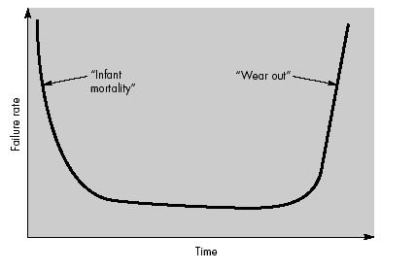
Software doesn't "wear out."
Failure curve
for hardware

Slide 9
Figure depicts failure rate as a function of time for hardware.
The relationship, often called the "bathtub curve," indicates that hardware exhibits relatively high failure rates early in its life
these failures are often attributable to design or manufacturing defects.
defects are corrected and the failure rate drops to a steady-state level (ideally, quite low) for some period of time.
As time passes, however, the failure rate rises again

Slide 10
hardware components suffer from the cumulative affects of dust, vibration, abuse, temperature extremes, and many other environmental maladies.
Stated simply, the hardware begins to wear out.

Slide 11
Software is not susceptible to the environmental maladies that cause hardware to wear out.
In theory, therefore, the failure rate curve for software should take the form of the “idealized curve”
Undiscovered defects will cause high failure rates early in the life of a program.
However, these are corrected (ideally, without introducing other errors) and the curve flattens as shown.
The idealized curve is a gross oversimplification of actual failure models for software. However, the implication is clear software doesn't wear out. But it does deteriorate!

Slide 12
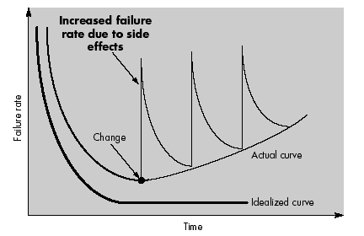

Slide 13
Another aspect of wear illustrates the difference between hardware and software.
When a hardware component wears out, it is replaced by a spare part.
There are no software spare parts.
Every software failure indicates an error in design or in the process through which design was translated into machine executable code.

Slide 14
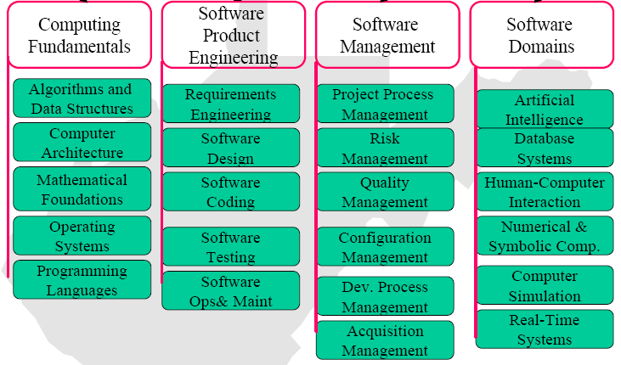
Software Engineering Body of Knowledge
Source: http://www.sei.cmu.edu/pub/documents/99.reports/pdf/99tr004.pdf

Slide 15
Software Applications
System software
System software is a collection of programs written to service other programs.
Some system software (e.g., compilers, editors, and file management utilities)
Other systems applications (e.g., operating system components, drivers, telecommunications the system software area is characterized by heavy interaction with computer hardware;

Slide 16
Real-time software.
Software that monitors/analyzes/controls real-world events as they occur is called real time.
Elements of real-time software include a data gathering component that collects and formats information from an external environment
An analysis component that transforms information as required by the application
a control/output component that responds to the external environment
and a monitoring component that coordinates all other components so that real-time response (typically ranging from 1 millisecond to 1 second) can be maintained.

Slide 17
Business software.
Business information processing is the largest single software application area.
Discrete "systems" (e.g., payroll, accounts receivable/payable, inventory) have evolved into management information system (MIS) software that accesses one or more large databases containing business information.

Slide 18
Engineering and scientific software.
Engineering and scientific software have been characterized by "number crunching" algorithms.
Applications range from astronomy to volcanology, from automotive stress analysis to space shuttle orbital dynamics, and from molecular biology to automated manufacturing.

Slide 19
Embedded software
Intelligent products have become commonplace in nearly every consumer and industrial market.
Embedded software resides in read-only memory and is used to control products and systems for the consumer and industrial markets.

Slide 20
Personal computer software
The personal computer software market has burgeoned over the past two decades.
Word processing, spreadsheets, computer graphics, multimedia, entertainment, database management, personal and business financial applications, external network, and database access are only a few of hundreds of applications.

Slide 21
Web-based software
The Web pages retrieved by a browser are software that incorporates executable instructions
(e.g., CGI, HTML, Perl, or Java), and data (e.g., hypertext and a variety of visual and audio formats).
In essence, the network becomes a massive computer providing an almost unlimited software resource that can be accessed by anyone with a modem.

Slide 22
Artificial intelligence software.
Artificial Intelligence (AI) software makes use of non-numerical algorithms to solve complex problems that are not amenable to computation or straightforward analysis.
Expert systems, also called knowledge based systems,
Pattern recognition (image and voice), artificial neural networks, theorem proving, and game playing are representative of applications within this category.

Slide 23
Software myths
Management myths
  Standards and procedures for building software
  Add more programmers if behind the schedule
Customer myths
  A general description of objectives enough to start coding
  Requirements may change as the software is flexible
Practitioner myths
  Task accomplished when the program works
  Quality assessment when the program is running
  Working program the only project deliverable

Slide 24
SOFTWARE MYTHS
Many causes of a software affliction can be traced to a mythology that arose during the early history of software development.
Unlike ancient myths that often provide human lessons well worth heeding, software myths propagated misinformation and confusion.

Slide 25
Management myths.
Myth: We already have a book that's full of standards and procedures for building software, won't that provide my people with everything they need to know?
Reality: The book of standards may very well exist, but is it used? Are software practitioners aware of its existence? Does it reflect modern software engineering practice? Is it complete? Is it streamlined to improve time to delivery while still maintaining a focus on quality? In many cases, the answer to all of these questions is "no."

Slide 26
Myth: My people have state-of-the-art software development tools, after all, we buy them the newest computers.
Reality: It takes much more than the latest model mainframe, workstation, or PC to do high-quality software development.
Computer-aided software engineering (CASE) tools are more important than hardware for achieving good quality and productivity, yet the majority of software developers still do not use them effectively.

Slide 27
Myth: If we get behind schedule, we can add more programmers and catch up (sometimes called the Mongolian horde concept).
Reality: Software development is not a mechanistic process like manufacturing.
In the words of Brooks [BRO75]: "adding people to a late software project makes it later.“
as new people are added, people who were working must spend time educating the newcomers, thereby reducing the amount of time spent on productive development effort.
People can be added but only in a planned and well-coordinated manner.

Slide 28
Myth: If I decide to outsource the software project to a third party, I can just relax and let that firm build it.
Reality: If an organization does not understand how to manage and control software projects internally,
it will invariably struggle when it outsource software projects.

Slide 29
Customer myths
Myth: A general statement of objectives is sufficient to begin writing programs we can fill in the details later.
Reality: A poor up-front definition is the major cause of failed software efforts.
A formal and detailed description of the information domain, function, behavior, performance, interfaces, design constraints, and validation criteria is essential.
These characteristics can be determined only after thorough communication between customer and developer.

Slide 30
Myth: Project requirements continually change, but change can be easily accommodated because software is flexible.
Reality: It is true that software requirements change, but the impact of change varies with the time at which it is introduced.
Figure illustrates the impact of change. If serious attention is given to up-front definition, early requests for change can be accommodated easily.
The customer can review requirements and recommend modifications with relatively little impact on cost. When changes are requested during software design, the cost impact grows rapidly.

Slide 31
Practitioner's myths.
Myth: Once we write the program and get it to work, our job is done.
Reality: Someone once said that "the sooner you begin 'writing code', the longer it'll take you to get done." Industry data ([LIE80], [JON91], [PUT97]) indicate that between 60 and 80 percent of all effort expended on software will be expended after it is delivered to the customer for the first time.

Slide 32
Myth: Until I get the program "running" I have no way of assessing its quality.
Reality: One of the most effective software quality assurance mechanisms can be applied from the inception of a project—the formal technical review.
Software reviews are a "quality filter" that have been found to be more effective than testing for finding certain classes of software defects.

Slide 33
Myth: The only deliverable work product for a successful project is the working program.
Reality: A working program is only one part of a software configuration that includes many elements.
Documentation provides a foundation for successful engineering and, more important, guidance for software support.

Slide 34
Myth: Software engineering will make us create voluminous and unnecessary documentation and will invariably slow us down.
Reality: Software engineering is not about creating documents.
It is about creating quality. Better quality leads to reduced rework.
And reduced rework results in faster delivery times.

Slide 35

What are the key challenges facing software engineering?
Software engineering in the 21st century faces three key challenges:
Legacy systems
  Old, valuable systems must be maintained and updated
Heterogeneity
  Systems are distributed and include a mix of hardware and software
Delivery
  There is increasing pressure
  for faster delivery of software

